Slide 1
Security
Geoff Huston
Chief Scientist, APNIC

Slide 2
Security
Insecurity!
Geoff Huston
Chief Scientist, APNIC

Slide 3
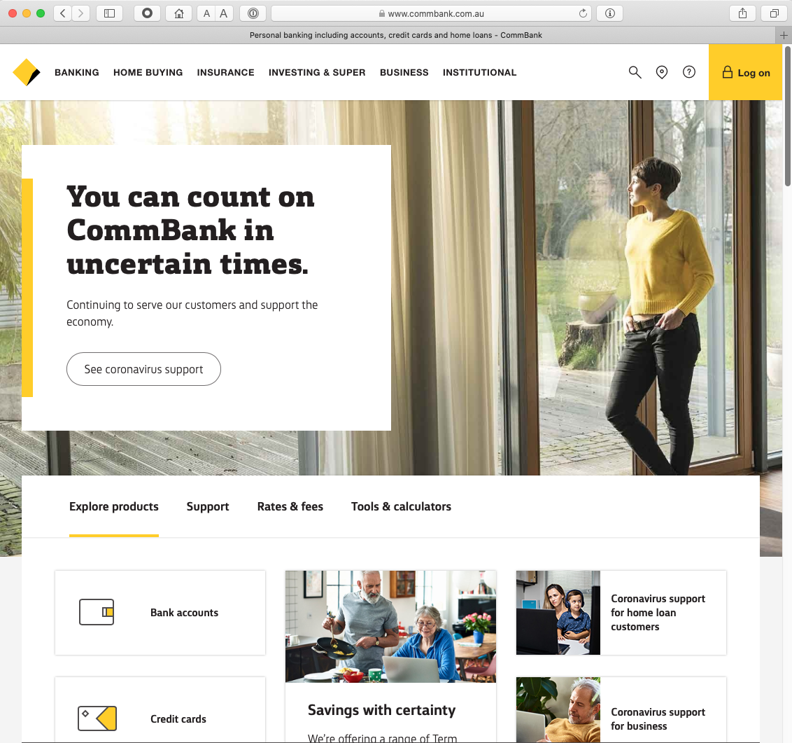
Which Bank?
Let’s start with a simple example:
Why should you pass your account and password to this web site? It might look like your bank, but frankly it could just as easily be a fraudulent site intended to steal your banking credentials. Why should you trust what you see on the screen?

Slide 4
Which Bank? My Bank!
Ok – its not a random example. It’s the online bank I use! But the same question is still there. Why should I trust this web page?

Slide 5
Which Bank? My Bank!
I hope!

Slide 6
Security on the Internet
How do you know that you are really going to where you thought you were going to?
Its trivial to mock up a web page to look like another

Slide 7
Security on the Internet
How do you know that you are really going to where you thought you were going to?
So why should I enter my username and password into this particular screen?
And what does this padlock icon really mean?
Its trivial to mock up a web page to look like another

Slide 8


Opening the Connection: First Steps
Client:
DNS Query:
www.commbank.com.au?
DNS Response:
23.215.58.96
TCP Session:
TCP Connect 23.215.58.96, port 443

Slide 9
Hang on…
$ dig -x 23.215.58.96 +short
a23-215-58-96.deploy.static.akamaitechnologies.com.

Slide 10
Hang on…
$ dig -x 23.215.58.96 +short
a23-215-58-96.deploy.static.akamaitechnologies.com.
That’s not an IP addresses that was allocated to the Commonwealth Bank!
  The Commonwealth Bank of Australia has the address blocks
  140.168.0.0 - 140.168.255.255 and
  203.17.185.0 - 203.17.185.255

Slide 11
Hang on…
$ dig -x 23.215.58.96 +short
a23-215-58-96.deploy.static.akamaitechnologies.com.
That’s an Akamai IP address
And I’m NOT a customer of the Internet Bank of Akamai!
Why should my browser trust that 23.215.58.96 is really the authentic web site for the Commonwealth Bank of Australia, and not some dastardly evil scam designed to steal my passwords and my money?
And why should I trust my browser?

Slide 12
The major question…
How does my browser tell the difference between an intended truth and a dastardly lie?

Slide 13
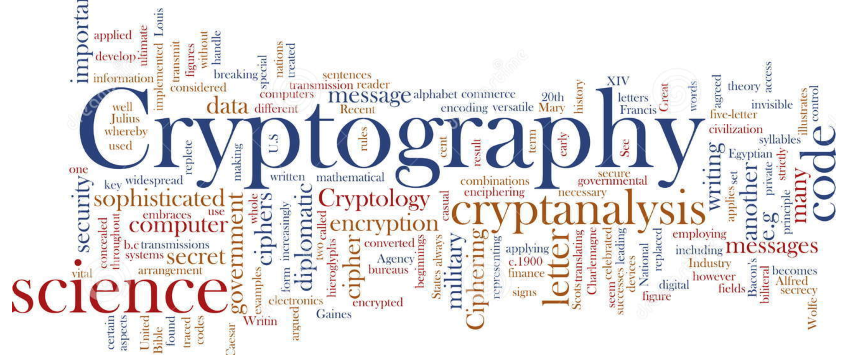
It’s all about cryptography

Slide 14
Public Key Cryptography
Pick a pair of keys such that:
  Messages encoded with one key can only be decoded with the other key
  Knowledge of the value of one key does not infer the value of the other key
  Make one key public, and keep the other a closely guarded private secret

Slide 15
This is important
So I will repeat it:
  Using public/private key cryptography requires a pair of keys (A,B) such that:
    Anything encrypted using key A can ONLY be decrypted using key B, and no other key
    Anything encrypted using key B can ONLY be decrypted using key A, and no other key
    Knowing the value of one key WILL NOT let you work out the value of the other key anytime soon!
This form of asymmetric cryptography lies at the heart of the Internet’s security framework

Slide 16
Public/Private Key Pairs
If I have a copy of your PUBLIC key, and you encrypt a message with your PRIVATE key, and I can decrypt the message using your public key
I know no one has tampered with your original message
I am confident that no one else has seen the contents of the message while it was passed through the network
And I know it was you that sent it.
And you can’t deny it.

Slide 17
Public Key Certificates
But how do I know this is YOUR public key?
  And not the public key of some dastardly evil agent pretending to be you?
I don’t know you
I’ve never met you
So I have absolutely no clue if this public key value is yours or not!

Slide 18
Public Key Certificates
What if I ‘trust’ an intermediary*?
  Who has contacted you and validated your identity and conducted a ‘proof of possession’ test that you have control of a private key that matches your public key
Then if the intermediary signs an attestation that this is your public key (with their private key) then I would be able to trust this public key
This ‘attestation’ takes the form of a “public key certificate”
* If you have ever used “public notaries” to validate a document, then this is a digital equivalent

Slide 19
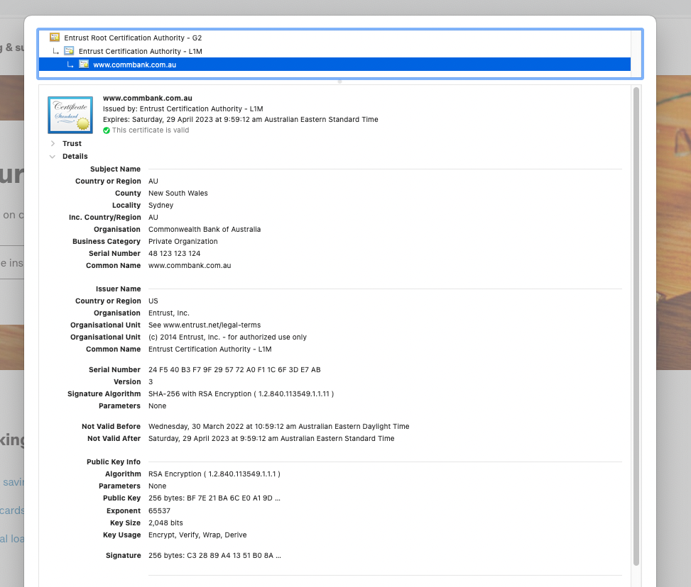
I trust that this is the web site of the Commonwealth Bank because I used the Commonwealth Bank’s public key to sete up the encrypted connection to the server.
And I can trust that this is the commonwealth Bank’s public key because I trust that Entrust has performed a number of checks before issuing a public key certificate for this public key

Slide 20
And another example
Lets take www.apnic.net and look at that certificate

Slide 21
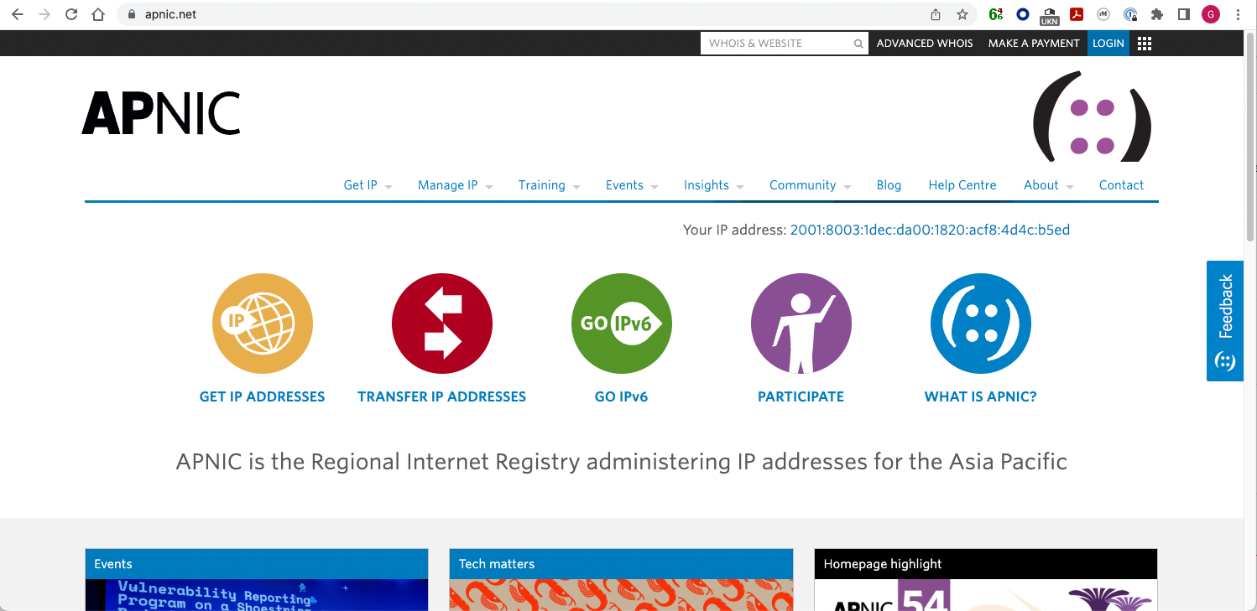

Slide 22
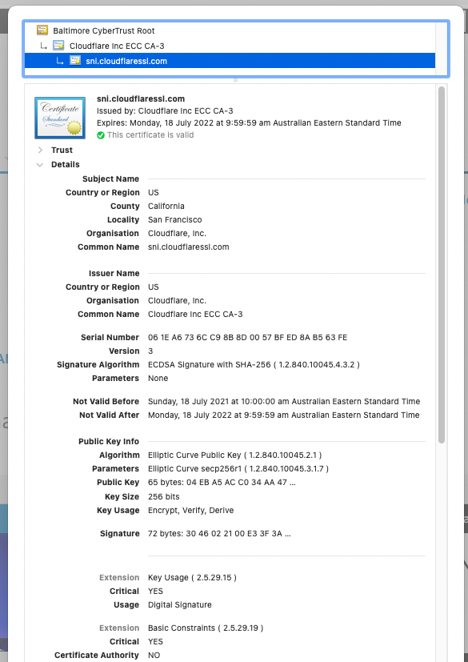

This certificate was issued to Cloudflare, not APNIC, and it is associated with the name “www.apnic.net through the use of a Subject Alternative Name in the certificate

Slide 23
And another
Let’s look at my own web site, with its certificate issued by Let’s Encrypt

Slide 24
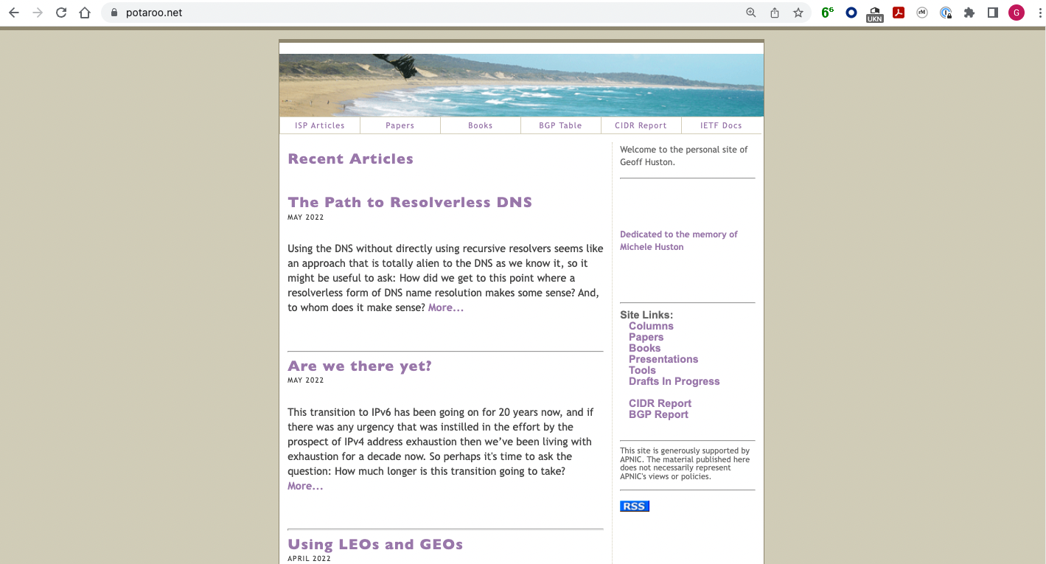
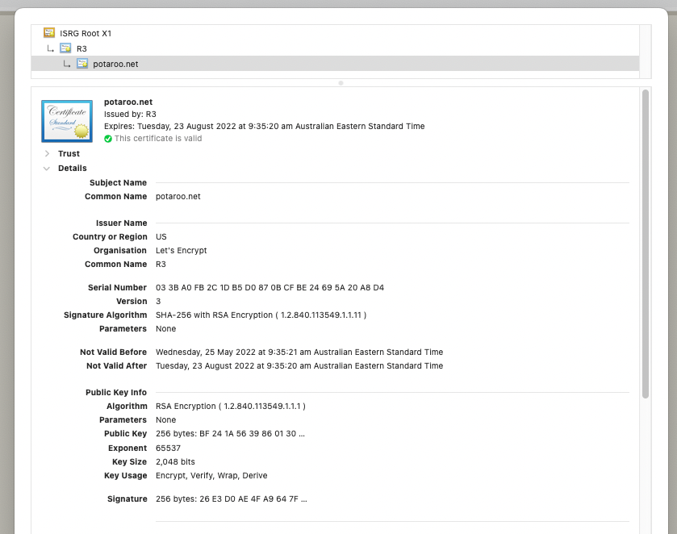
This certificate binds a public key to a domain name without any attestation to the identity of the name “holder”

Slide 25
Spot the Difference
Safari
Chrome

Slide 26
Spot the Difference
Safari
Chrome
This web site’s certificate was issued to an organisation called the “Commonwealth Bank of Australia” located in Sydney, Australia
This web site’s certificate was issued to “Cloudflare Inc” located in San Francisco, USA!!
This web site’s certificate says nothing about the entity that holds the public key associated with this domain

Slide 27
Spot the Difference
The certification processes taken to issue the certificate were different in each of these cases.
  One confirmed the identity of the public key holder as well as their association with the domain name
  The second used a proxy agent and there is no association between the entity domain name that is certified here and the proxy agent
  The third simply associates a public key with a domain name without any form of identification of the holder of the domain name
They all have different levels of trustworthiness, yet they all display to the user in exactly the same way
  Because when we tried to differentiate these different levels of trust (such as painting the padlock icon in green) nobody understood what was going on and nobody cared anyway!

Slide 28
Moving on…
Ok, so the certificate system is a mess, but TLS still works, right?
So lets look at the way TLS sets of a secure session

Slide 29
Secure Connections using TLS
https://rhsecurity.wordpress.com/tag/tls/

Slide 30
Secure Connections using TLS
https://rhsecurity.wordpress.com/tag/tls/

Slide 31
Secure Connections using TLS
https://rhsecurity.wordpress.com/tag/tls/

Slide 33
Secure Connections using TLS
How does the client
recognise this certificate
as the “right” certificate?
https://rhsecurity.wordpress.com/tag/tls/

Slide 34
How did my browser know that this is a “valid” cert?

Slide 35
Domain Name Certification
The Commonwealth Bank of Australia has generated a key pair
And they passed a certificate signing request to a company called “Entrust” in the US
Who was willing to vouch (in a certificate) that the entity is called the Commonwealth Bank of Australia and they have control of the the domain name www.commbank.com.au and they have a certain public key
So, if I can associate this public key with a connection then I have a high degree of confidence that I’ve connected to an entity that is able to demonstrate knowledge of the private key for www.commbank.com.au, as long as I am prepared to trust Entrust and the certificates that they issue
And I’m prepared to trust them because Entrust NEVER lie!

Slide 36
Domain Name Certification
The Commonwealth Bank of Australia has generated a key pair
And they passed a certificate signing request to a company called “Entrust” in the US
Who was willing to vouch (in a certificate) that the entity is called the Commonwealth Bank of Australia and they have control of the the domain name www.commbank.com.au and they have a certain public key
So, if I can associate this public key with a connection then I have a high degree of confidence that I’ve connected to an entity that is able to demonstrate knowledge of the private key for www.commbank.com.au, as long as I am prepared to trust Entrust and the certificates that they issue
And I’m prepared to trust them because Entrust NEVER lie!
How do I know that? Why should I trust them?

Slide 37
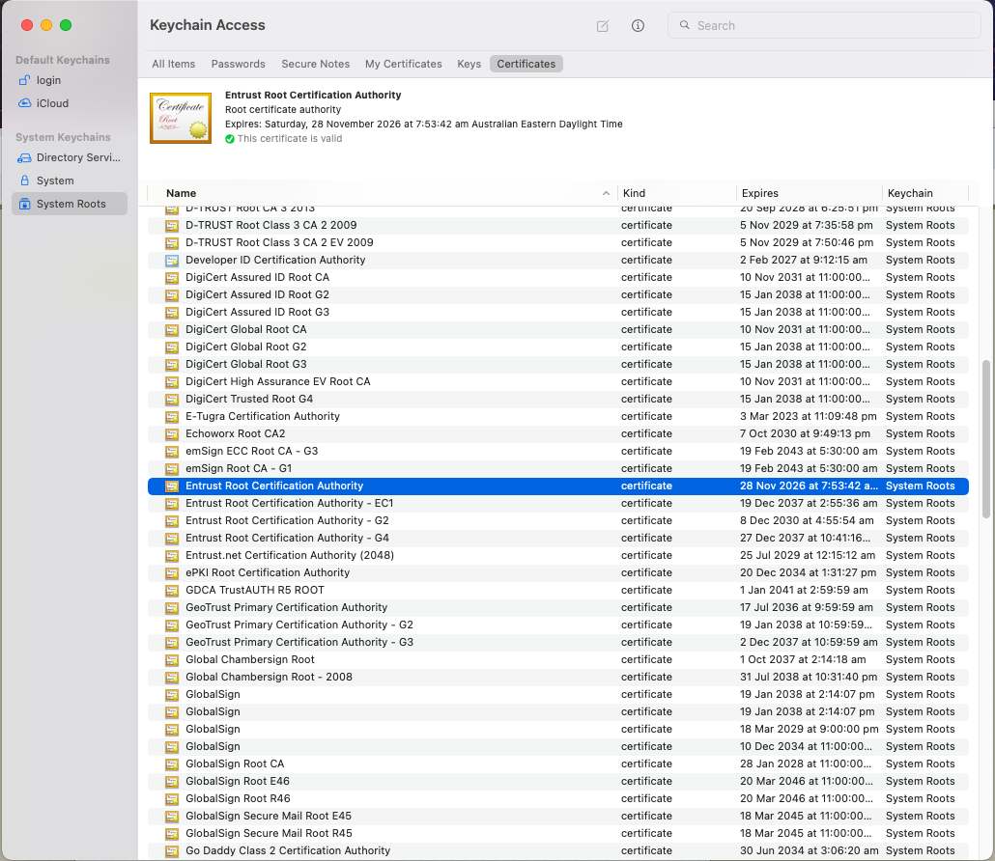
Local Trust
The cert I’m being asked to trust was issued by a certification authority that my browser already trusts – so I trust that cert!

Slide 38
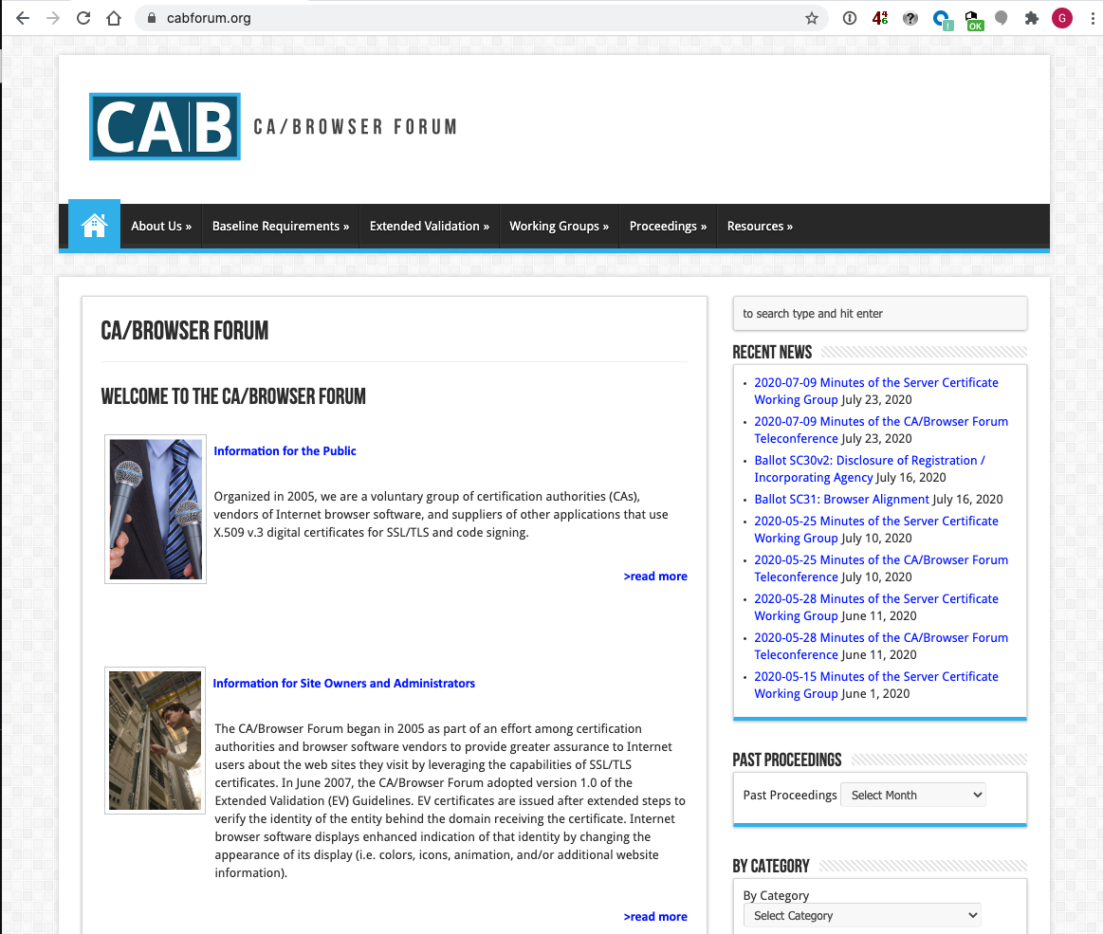
Local Trust
These Certificate Authorities are listed in my computer’s trust set because they claim to operate according to the practices defined by the CAB industry forum (of which they are a member) and they never lie!

Slide 39
Local Trust
These Certificate Authorities are listed in my computer’s trust set because they claim to operate according to the practices defined by the CAB industry forum (of which they are a member) and they never lie!
So somebody (I have never met) paid someone else (whom I have also never met) some money and then my browser trusts everything they have ever done and everything they will ever do in the future – ok?

Slide 40
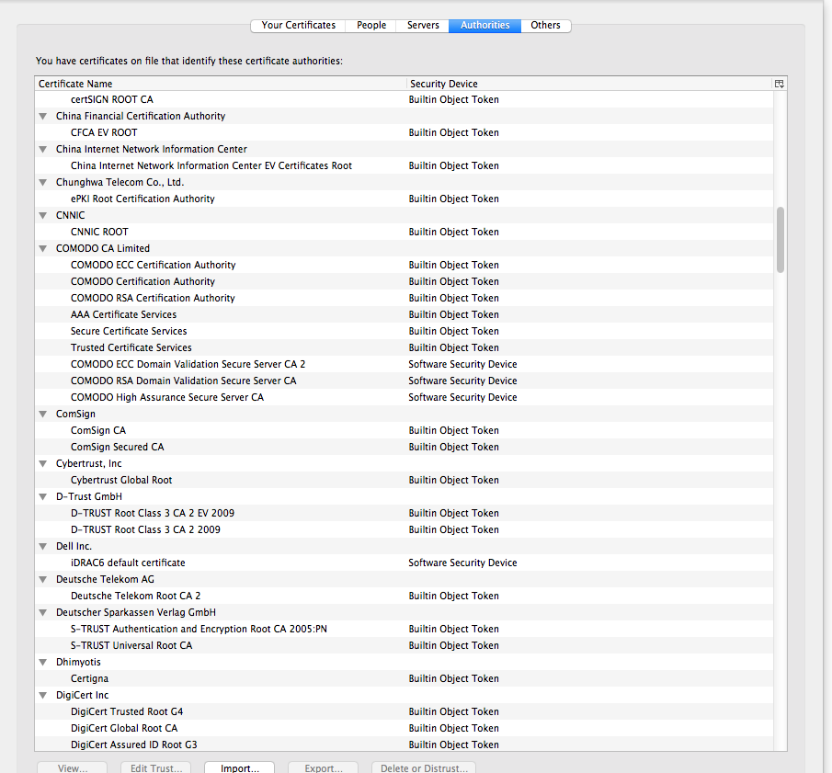
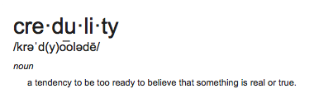
Local Trust or Local Credulity*?
Wow!
Are they all trustable?
*

Slide 41
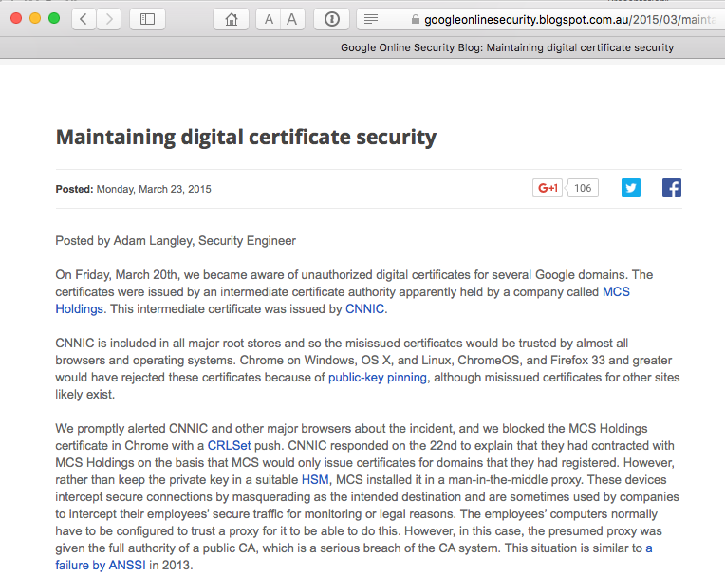
Local Credulity
Wow!
Are they all trustable?
Evidently Not!

Slide 42
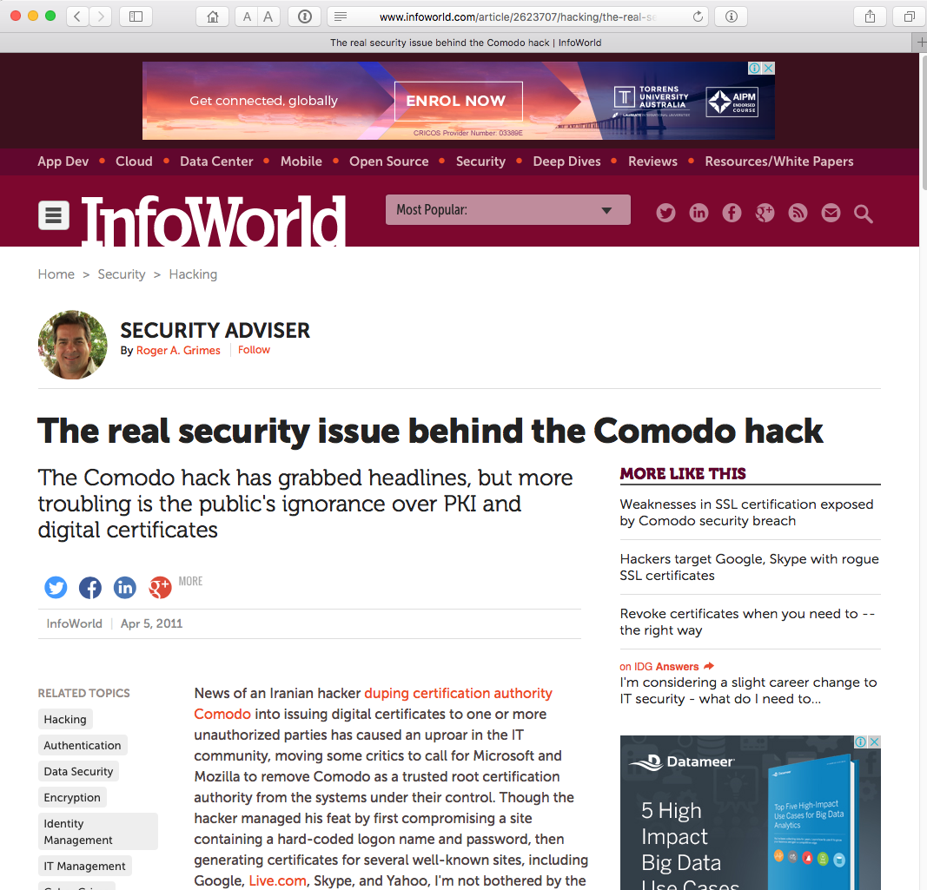
Local Credulity
Wow!
Are they all trustable?
Evidently Not!

Slide 43
Never?

Slide 44
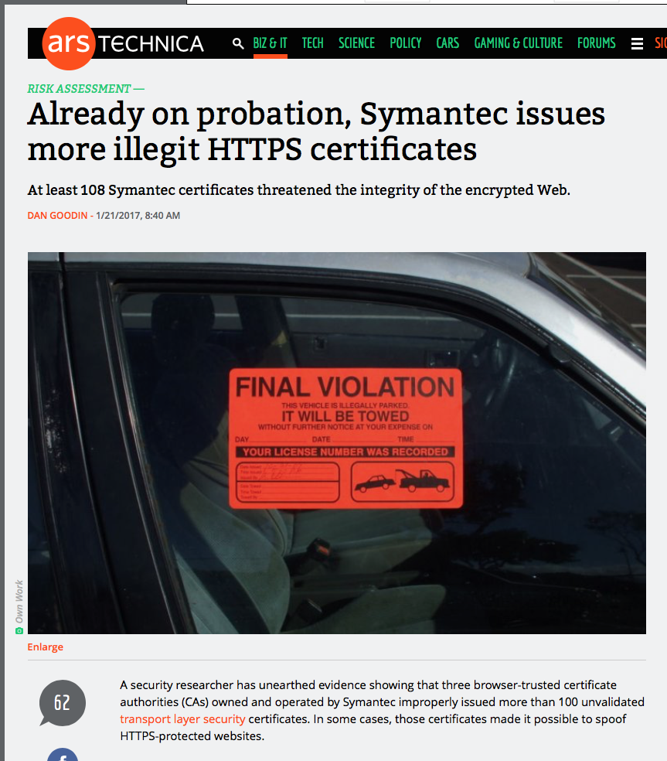
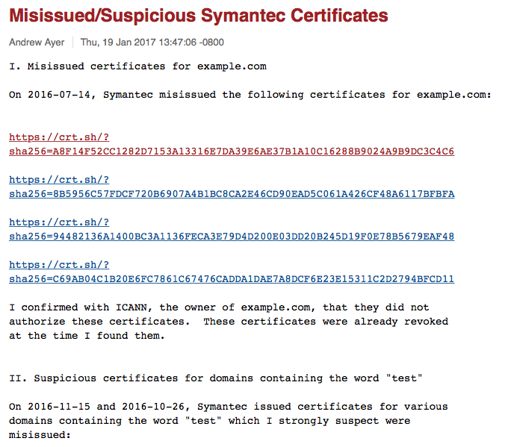
Well, hardly ever
http://arstechnica.com/security/2017/01/already-on-probation-symantec-issues-more-illegit-https-certificates/

Slide 45
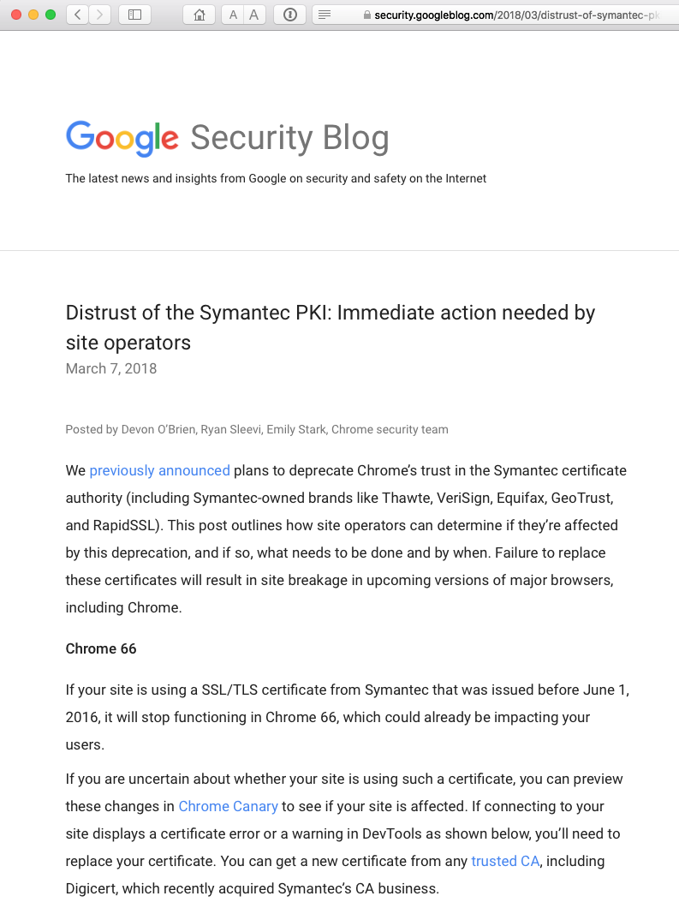
Well, hardly ever

Slide 46
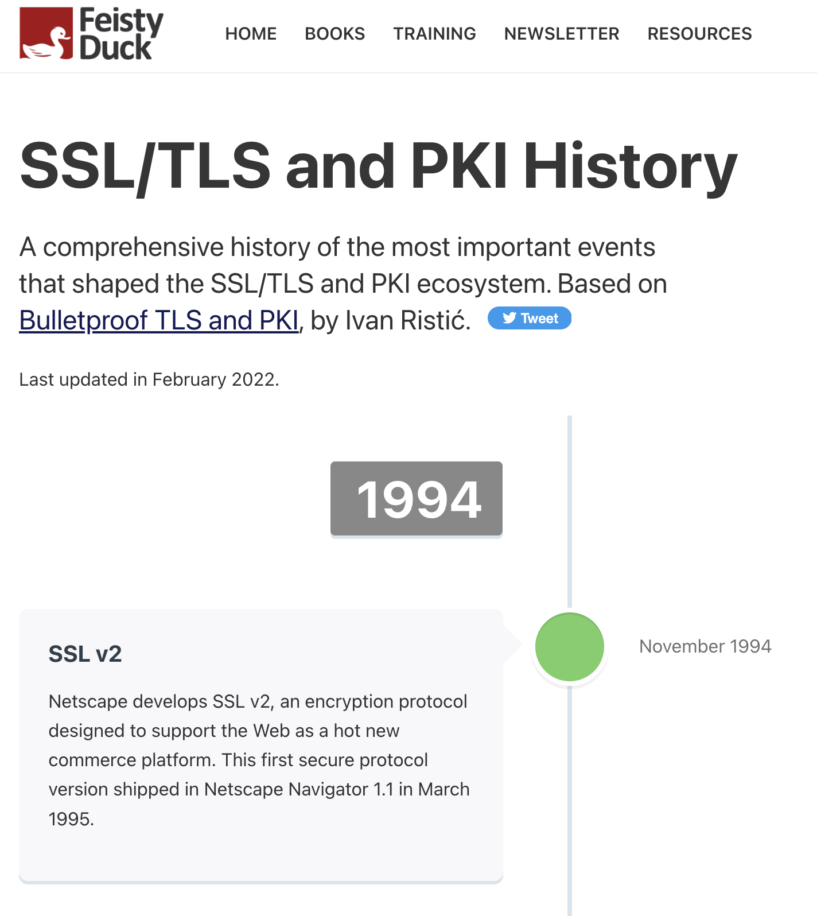
These are isolated events
No they’re not:
https://www.feistyduck.com/ssl-tls-and-pki-history/

Slide 47
With unpleasant consequences when it all goes wrong

Slide 48
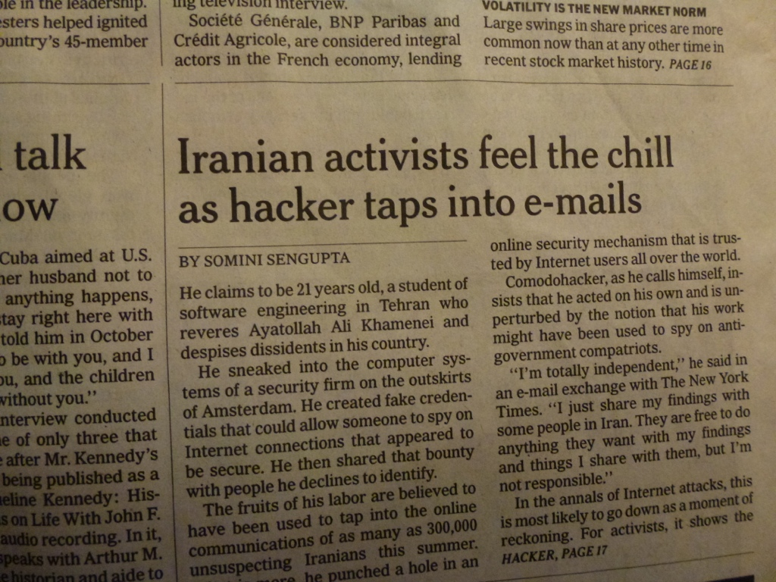
With unpleasant consequences when it all goes wrong
International Herald Tribune
Sep 13, 2011 Front Page

Slide 49
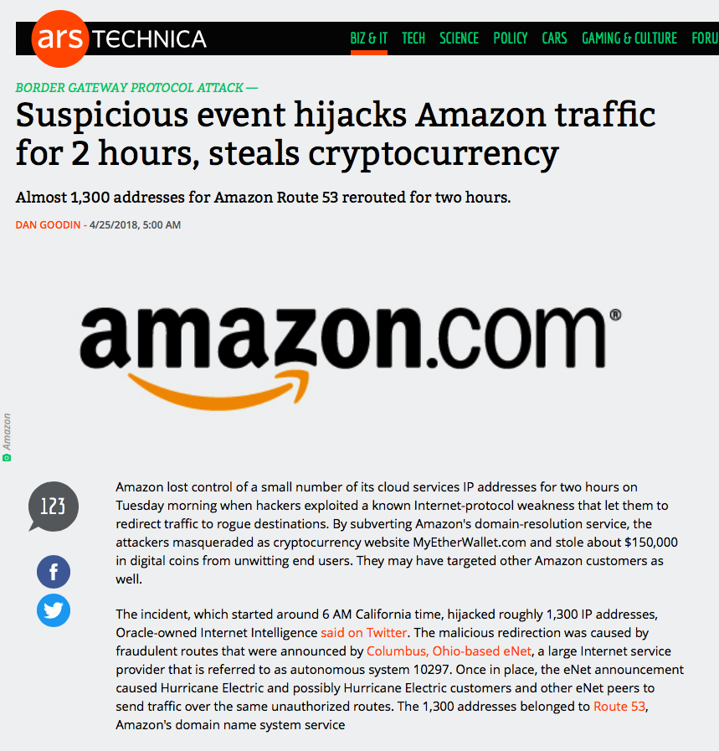

Slide 50
What’s going wrong here?

Slide 51
What’s going wrong here?
The TLS handshake cannot specify WHICH CA should be used by the client to validate the digital certificate that describes the server’s public key
The result is that your browser will allow ANY CA to be used to validate a certificate!

Slide 52
What’s going wrong here?
The TLS handshake cannot specify WHICH CA should be used by the client to validate the digital certificate that describes the server’s public key
The result is that your browser will allow ANY CA to be used to validate a certificate!
WOW! That’s awesomely bad!

Slide 53
What’s going wrong here?
The TLS handshake cannot specify WHICH CA should be used by the client to validate the digital certificate that describes the server’s public key
The result is that your browser will allow ANY CA to be used to validate a certificate!
Here’s a lock – it might be the lock on your front door for all I know.
The lock might LOOK secure, but don’t worry – literally ANY key can open it!
WOW! That’s awesomely bad!

Slide 54
What’s going wrong here?
There is no incentive for quality in the CA marketplace
Why pay more for any certificate when the entire CA structure is only as strong as the weakest CA
And your browser trusts a LOT of CAs!
  About 60 – 100 CA’s
  About 1,500 Subordinate RA’s
  Operated by 650 different organisations
See the EFF SSL observatory
http://www.eff.org/files/DefconSSLiverse.pdf

Slide 55
In a Commercial Environment
Where CA’s compete with each other for market share
And quality offers no protection
Then what ‘wins’ in the market?
Sustainable
?
Resilient
Secure
Privacy
Trusted

Slide 56

In a Commercial Environment
Where CA’s compete with each other for market share
And quality offers no protection
Then what ‘wins’ in the market?
Sustainable
Cheap!
Resilient
Secure
Privacy
Trusted

Slide 57
But its all OK
Really.
Because ‘bad’ certificates can be revoked
And browsers always check revocation status of certificates before they trust them

Slide 58
Always?

Slide 59
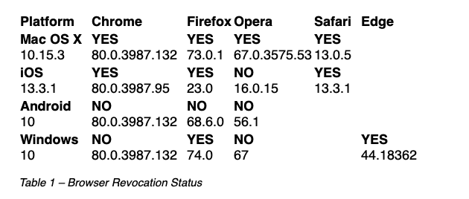
Ok – Not Always.
Some do.
Sometimes.
https://www.potaroo.net/ispcol/2020-03/revocation.html

Slide 60
So we can’t count on revocation
If we can’t revoke certificates then we need to reduce certificate lifetimes

Slide 61

So we can’t count on revocation
If we can’t revoke certificates then we need to reduce certificate lifetimes
But we are not doing that!
Yes, 2026!!!
Yes, 2023!!!

Slide 62
So we can’t count on revocation
If we can’t revoke certificates then we need to reduce certificate lifetimes
What’s a “safe” certificate lifetime?

Slide 63
So we can’t count on revocation
If we can’t revoke certificates then we need to reduce certificate lifetimes
What’s a “safe” certificate lifetime?
If we want 2 hours or less then we need to think hard about how to achieve this

Slide 64
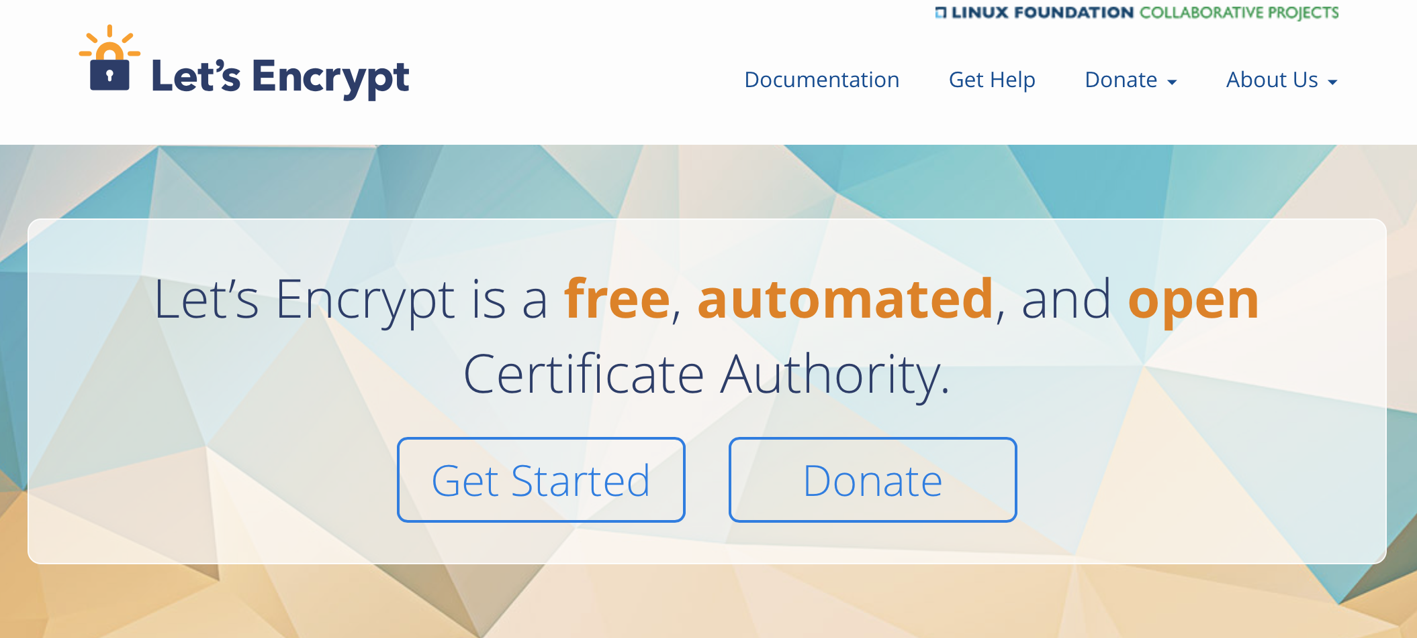
How can we make certificates better?
Option A: Take all the money out of the system!

Slide 65
How can we make certificates better?
Option A: Take all the money out of the system!
Will the automation of the Cert Issuance coupled with a totally free service make the overall environment more or less secure?
I think we already know the answer!

Slide 66
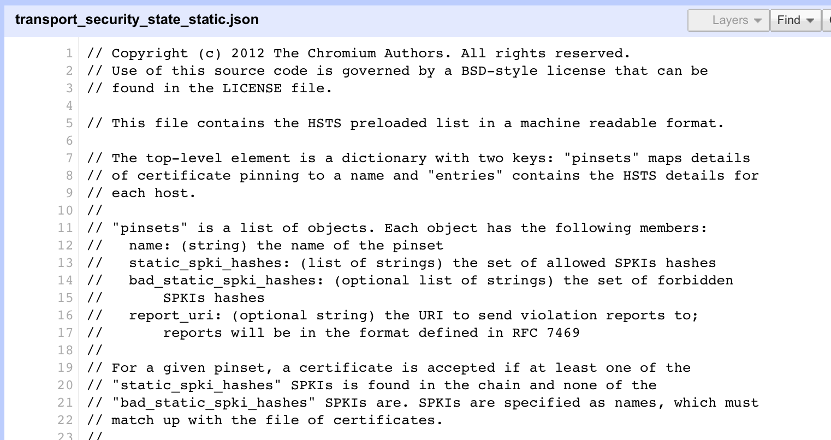
How can we make certificates better?
Option B: White Listing and Pinning with HSTS
https://code.google.com/p/chromium/codesearch#chromium/src/net/http/transport_security_state_static.json

Slide 67
How can we make certificates better?
Option B: White Listing and Pinning with HSTS
https://code.google.com/p/chromium/codesearch#chromium/src/net/http/transport_security_state_static.json
Its not a totally insane idea -- until you realise that it appears to be completely unscaleable!
Its just Google protecting itself and no one else

Slide 68
How can we make certificates better?
Its not a totally insane idea -- until you realise that it appears to be completely unscaleable!
Its just Google protecting itself and no one else
Option B: White Listing and Pinning with HSTS
https://code.google.com/p/chromium/codesearch#chromium/src/net/http/transport_security_state_static.json

Slide 69
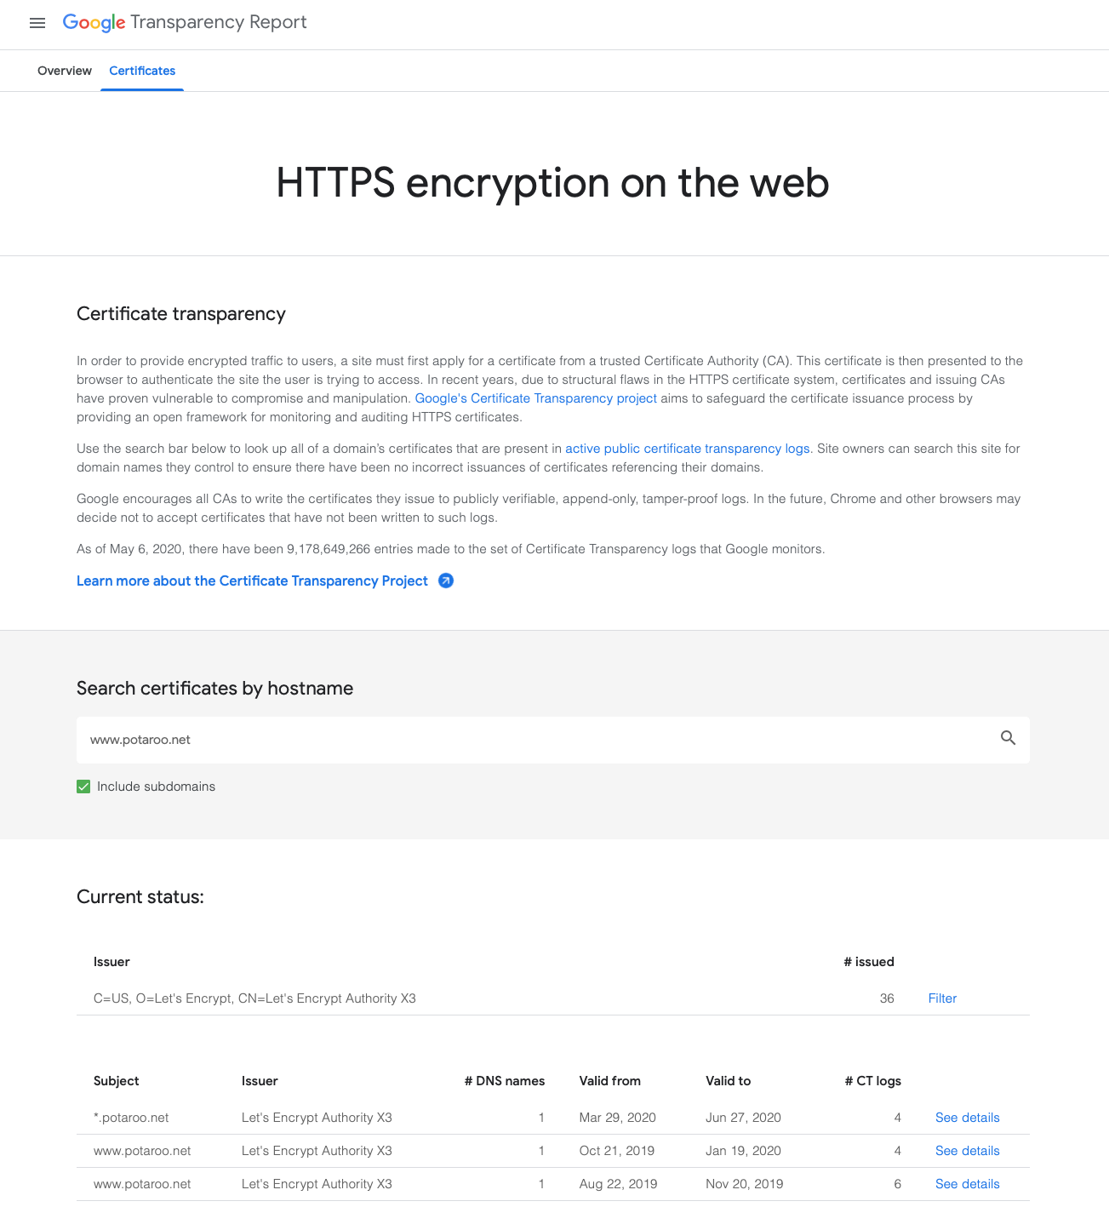
How can we make certificates better?
Option C: Certificate Transparency

Slide 70
How can we make certificates better?
Option C: Certificate Transparency
This is true
This is a fail

Slide 71
How can we maske certificates better?
Option C: Certificate Transparency
Its just so broken
These transparency logs are a case of same week service in a millisecond world -- Assuming anyone looks in the first place!
Cert Transparency is probably worse than a placebo!

Slide 72
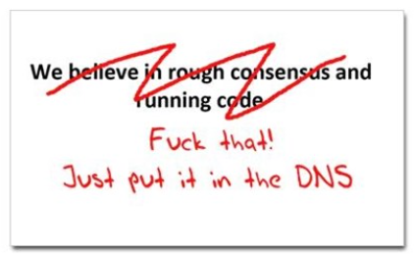
How can we make certificates better?
Option D: Use the DNS!
www.cafepress.com/nxdomain

Slide 73
Seriously? The DNS?
Where better to find out the public key associated with a DNS-named service than to look it up in the DNS?
  Why not query the DNS for the HSTS record?
  Why not query the DNS for the issuer CA?
  Why not query the DNS for the hash of the domain name cert?
  Why not query the DNS for the hash of the domain name public key?

Slide 74
Seriously? The DNS?
Where better to find out the public key associated with a DNS-named service than to look it up in the DNS?
  Why not query the DNS for the HSTS record?
  Why not query the DNS for the issuer CA?
  Why not query the DNS for the hash of the domain name cert?
  Why not query the DNS for the hash of the domain name public key?
Who needs CA’s anyway?

Slide 75
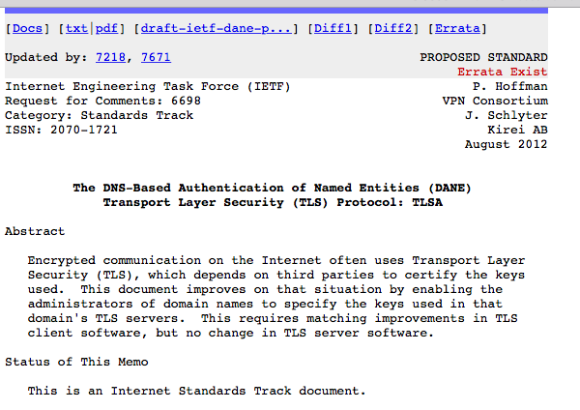
DANE
Using the DNS to associated domain name public key certificates with domain name
RFC6698 -- You should read this!

Slide 76
TLS with DANE
Client receives server cert in Server Hello
  Client lookups the DNS for the TLSA Resource Record of the domain name
  Client validates the presented certificate against the TLSA RR
Client performs Client Key exchange

Slide 77
TLS Connections
DNS Name
DNS TLSA query
Public Key
Cert
https://rhsecurity.wordpress.com/tag/tls/

Slide 78
Just one problem…
The DNS is full of liars and lies!
And this can compromise the integrity of public key information embedded in the DNS
Unless we fix the DNS we are no better off than before with these TLSA records!

Slide 79
Just one response…
We need to allow users to validate DNS responses for themselves
And for this we need a Secure DNS framework
Which we have – and it’s called DNSSEC!

Slide 80
DANE + DNSSEC
Query the DNS for the TLSA record of the domain name and ask for the DNSSEC signature to be included in the response
Validate the signature to ensure that you have an unbroken signature chain to the root trust point
At this point you can accept the TLSA record as the authentic record, and set up a TLS session based on this data

Slide 81
DANE + DNSSEC
Query the DNS for the TLSA record of the domain name and ask for the DNSSEC signature to be included in the response
Validate the signature to ensure that you have an unbroken signature chain to the root trust point
At this point you can accept the TLSA record as the authentic record, and set up a TLS session based on this data
Yes, but No!

Slide 82
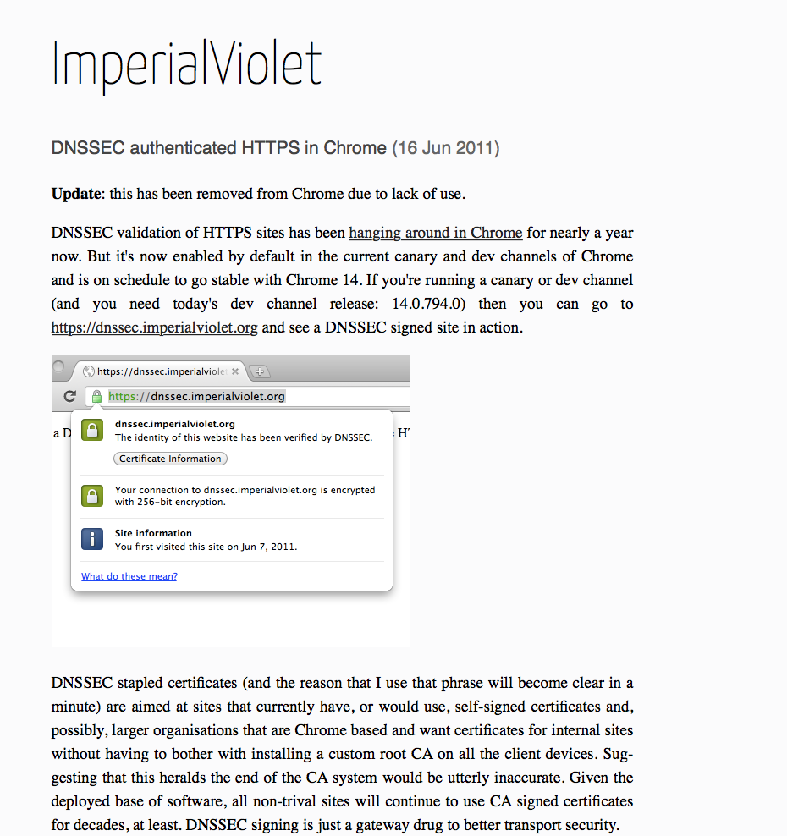
DANE + DNSSEC
DANE validation can be SO SLOW!

Slide 83
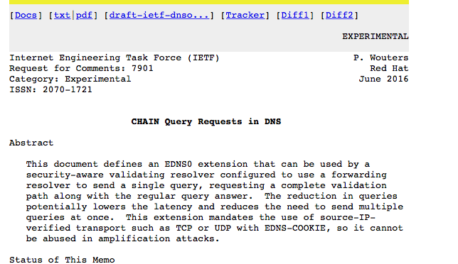
Or…
Faster validation?

Slide 84
Or … Look! No DNS!
Server packages server cert, TLSA record and the DNSSEC credential chain in a single bundle
Client receives bundle in Server Hello
  Client performs validation of TLSA Resource Record using the supplied DNSEC signatures plus the local DNS Root Trust Anchor without performing any DNS queries
  Client validates the presented certificate against the TLSA RR
Client performs Client Key exchange

Slide 85
Doing a better job
We could do a far better job at Internet Security by moving on from X.509 public key certificates:
Publishing DNSSEC-signed zones
Publishing DANE TLSA records
Using DNSSEC-validating resolution
Using TLSA records to guide TLS Key Exchange
Stapling the TLSA + sig bundle into TLS

Slide 86
Doing a better job
We could do a far better job at Internet Security by moving on from X.509 public key certificates:
Publishing DNSSEC-signed zones
Publishing DANE TLSA records
Using DNSSEC-validating resolution
Using TLSA records to guide TLS Key Exchange
Stapling the TLSA + sig bundle into TLS
But nothing has happened for more than a decade!
Why not?

Slide 87
Why is this so hard?

Slide 88
Why is this so hard?
We have different goals
  Some people want to provide strong hierarchical controls on the certificates and keys because it entrenches their role in providing services
  Some want to do it because it gives them a point of control to intrude into the conversations of their citizens
  Others want to exploit weaknesses in the system to leverage a competitive advantage
  Some people think users prefer faster applications, even if they have security weaknesses
  Others think users are willing to pay a time penalty for better authentication controls

Slide 89
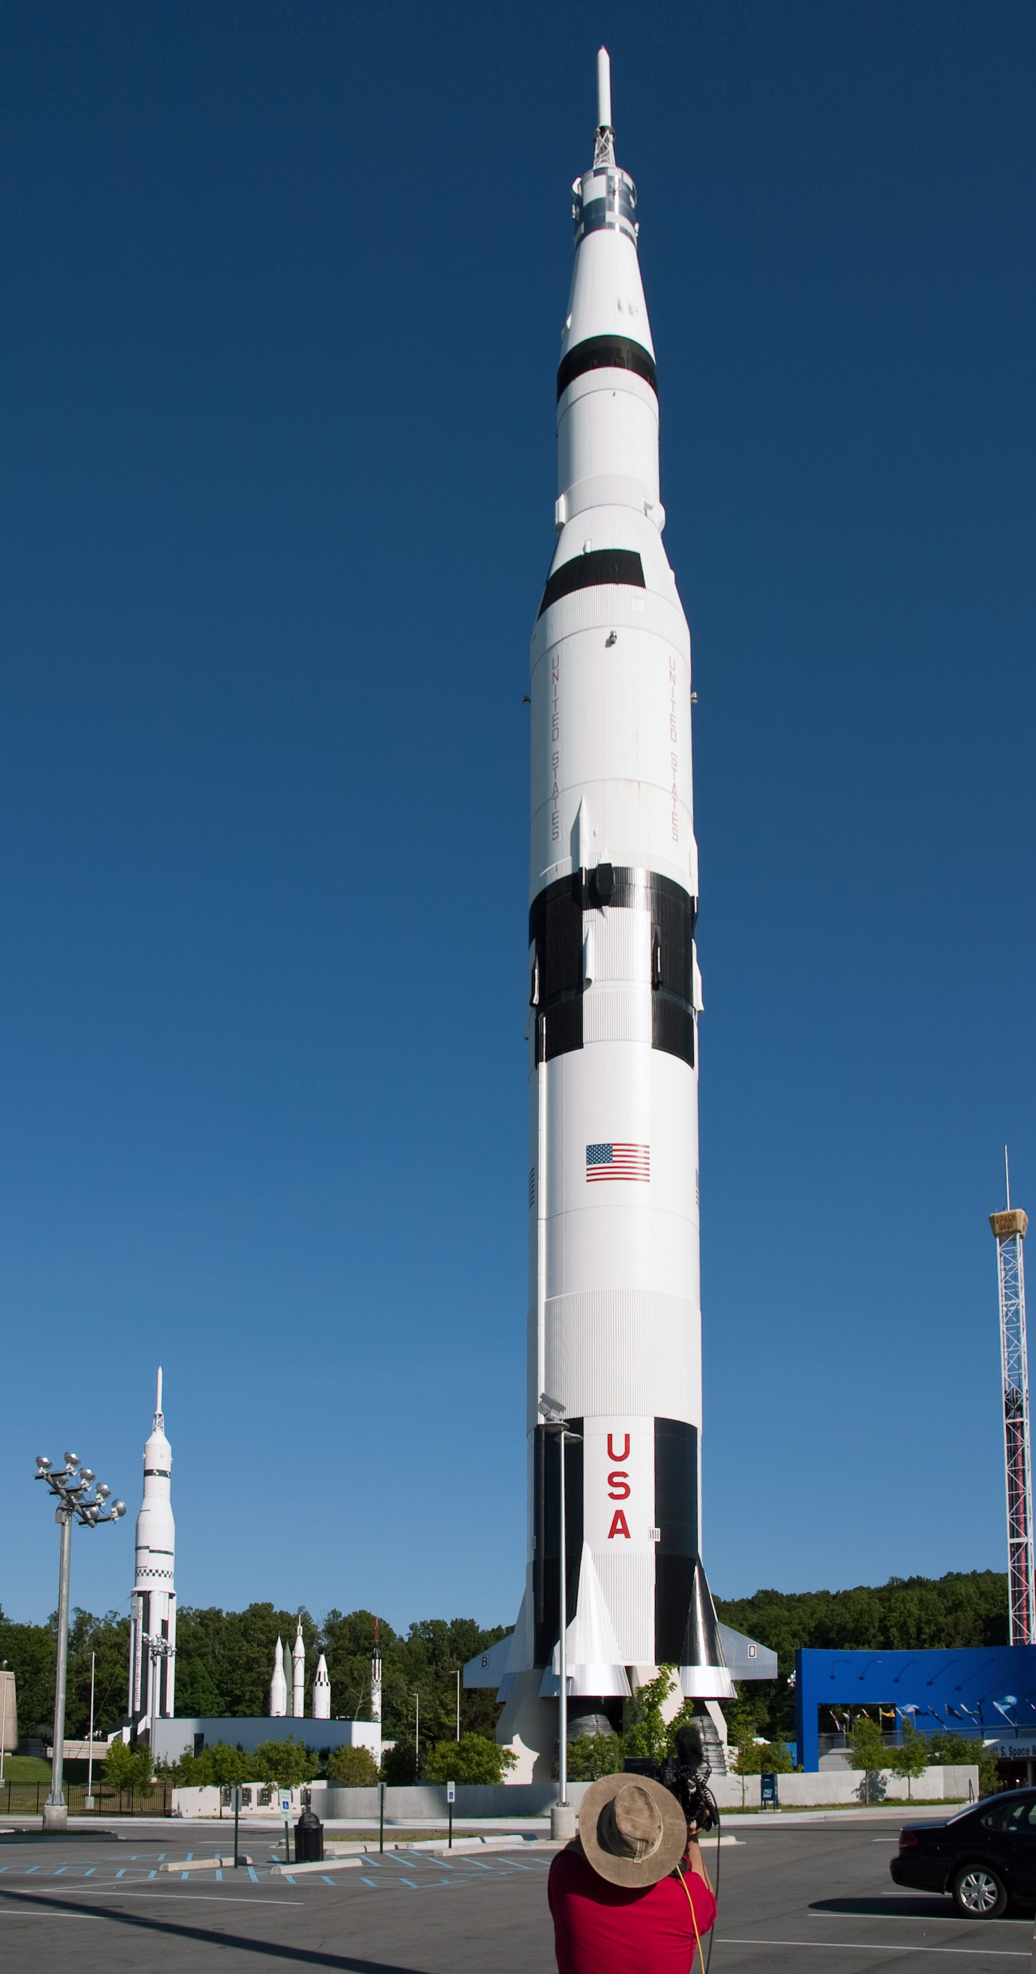
Why is this so hard?
Because there are so many moving parts?
  In a system that is constructed upon the efforts of multiple systems and multiple providers we are relying on someone in charge to orchestrate the components to as working whole
Saturn V Launch Vehicle
Three stage rocket, each built by a different contractor
Each of whom used multiple subcontractors
3 million components
Each supplied by the lowest bidder!

Slide 90
Why is this so hard?
Because we are relying on the market to provide coherence and consistency of orchestration across providers?
  And perhaps that’s the key point here
  Loosely coupled systems will always present windows of vulnerability
    Routing integrity
    Name registration
    Name certification
    Service control
  Effective defence involves not only component defence but also in defending the points of interaction between components
  And we find this very hard to achieve when the market itself is the orchestration agent

Slide 91
Users and Trust
Users just want to be able to trust that the websites and services that they connect to and share their credentials, passwords and content with are truly the ones they expected to be using without first studying for a PhD in Network Operational Security
Somehow we’re missing that simple objective and we’ve interposed complexity and adornment that have taken on a life of their own and are in fact eroding trust
And that’s bad!
If we can’t trust our communications infrastructure, then we don’t have a useful communications infrastructure.

Slide 92
What a dysfunctional mess we’ve created!

Slide 93
Can we make it better?
We could do a better job if we knew what we wanted

Slide 94
Can we make it better?
We could do a better job if we knew what we wanted
  Single point of trust for EVERTHING (DNSSEC)
  or
  Many points of trust in a highly distributed framework (Web PKI)

Slide 95
Can we make it better?
We could do a better job if we knew what we wanted
  Highly robust validation performed by the client
  or
  Fast!

Slide 96
Can we make it better?
We could do a better job if we knew what we wanted
  Single common secure credential infrastructure
  or
  Application-specific credentials

Slide 97
Can we make it better?
Yes, if we could only agree on what we want in the first place!
And we just can’t agree on that!

Slide 98
That’s it!
Questions?

